Slide 1
UP is divided into four phases, named:
Inception
Elaboration
Construction
Transition

Slide 2
Inception - Define the scope of project.
Elaboration - Plan project, specify features, baseline architecture.
Construction - Build the product
Transition - Transition the product into end user community

Slide 3
Inception –approximate vision, business case, scope ,vague estimates
  Not requirement phase, checking for feasibility (proceed or not)
Elaboration-refined vision, iterative implementation of the core architecture ,resolution of high risks, identification of most requirements and scope ,more realistic estimates

Slide 4
Construction
  Iterative implementation of the remaining lower risk and easier elements and preparation for deployment.
Transition
  Beta tests, deployment

Slide 5
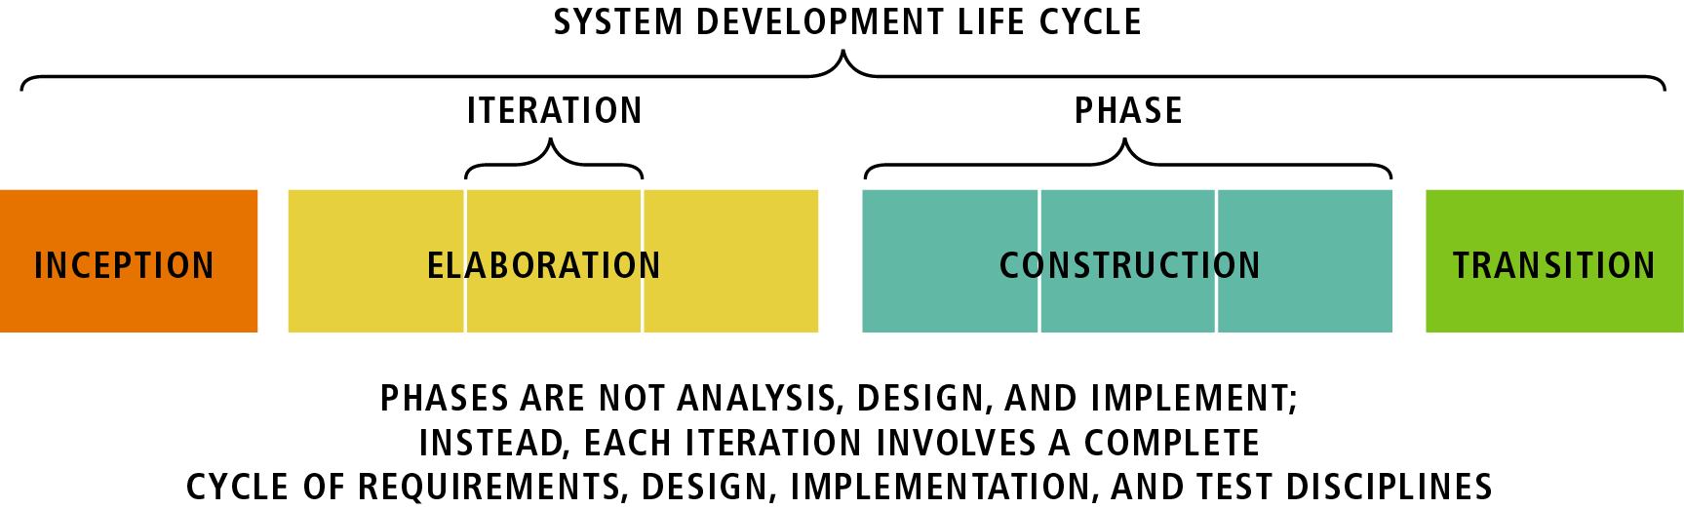
Inception –not a requirement phase: It is a feasibility phase :Investigation is done to support a decision to continue or stop
Elaboration –not requirement or design phase:
It is a phase where the core architecture is iteratively implemented and high risk issues are mitigated.
Construction: continue design and implementation
Transition: move the system into operational mode

Slide 6
artifact
Any work product
Code
Web graphics
Db schema
Text document
Diagrams
models

Slide 7

Inception –not a requirement phase: It is a feasibility phase :Investigation is done to support a decision to continue or stop
Elaboration –not requirement or design phase:
It is a phase where the core architecture is iteratively implemented and high risk issues are mitigated.
Construction: continue design and implementation
Transition: move the system into operational mode

Slide 8
Inception
The life-cycle objectives of the project are stated, so that the needs of every stakeholder are considered. Scope and boundary conditions, acceptance criteria and some requirements are established.

Slide 9
Entry Criteria
• The expression of a need, which can take any
of the following forms:
▪ an original vision
▪ a legacy system
▪ an RFP (request for proposal)
▪ the previous generation and a list of
enhancements
▪ some assets (software, know-how, financial
assets)
▪ a conceptual prototype, or a mock-up

Slide 10
Inception - Activities
Formulate the scope of the project.
Needs of every stakeholder, scope, boundary conditions and acceptance criteria established.
Plan and prepare the business case.
Define risk mitigation strategy, develop an initial project plan and identify known cost, schedule, and profitability trade-offs.
Synthesize candidate architecture.
Candidate architecture is picked from various potential architectures
Prepare the project environment.

Slide 11
Inception - Exit criteria
An initial business case containing at least a clear formulation of the product vision - the core requirements - in terms of functionality, scope, performance, capacity, technology base.
Success criteria (example: revenue projection).
An initial risk assessment.
An estimate of the resources required to complete the elaboration phase.

Slide 12
Elaboration
An analysis is done to determine the risks, stability of vision of what the product is to become, stability of architecture and expenditure of resources.

Slide 13
Elaboration - Entry criteria
The products and artifacts described in the exit criteria of the previous phase.
The plan approved by the project management, and funding authority, and the resources required for the elaboration phase have been allocated.

Slide 14
Elaboration - Activities
Define the architecture.
Project plan is defined. The process, infrastructure and development environment are described.
Validate the architecture.
Baseline the architecture.
To provide a stable basis for the bulk of the design and implementation effort in the construction phase.

Slide 15
Elaboration - Exit criteria
A detailed software development plan, with an updated risk assessment, a management plan, a staffing plan, a phase plan showing the number and contents of the iteration , an iteration plan, and a test plan
The development environment and other tools
A baseline vision, in the form of a set of evaluation criteria for the final product
A domain analysis model, sufficient to be able to call the corresponding architecture ‘complete’.
An executable architecture baseline.

Slide 16
Construction
The Construction phase is a manufacturing process. It emphasizes managing resources and controlling operations to optimize costs, schedules and quality. This phase is broken into several iterations.

Slide 17
Construction - Entry criteria
The product and artifacts of the previous iteration. The iteration plan must state the iteration specific goals
Risks being mitigated during this iteration.
Defects being fixed during the iteration.

Slide 18
Construction - Activities
Develop and test components.
Components required satisfying the use cases, scenarios, and other functionality for the iteration are built. Unit and integration tests are done on Components.
Manage resources and control process.
Assess the iteration
Satisfaction of the goal of iteration is determined.

Slide 19
Construction - Exit Criteria
The same products and artifacts, updated, plus:
A release description document, which captures the results of an iteration
Test cases and results of the tests conducted on the products,
An iteration plan, detailing the next iteration
Objective measurable evaluation criteria for assessing the results of the next iteration(s).

Slide 20
Transition
The transition phase is the phase where the product is put in the hands of its end users. It involves issues of marketing, packaging, installing, configuring, supporting the user-community, making corrections, etc.

Slide 21
Transition - Entry criteria
The product and artifacts of the previous iteration, and in particular a software product sufficiently mature to be put into the hands of its users.

Slide 22
Transition - Activities
Test the product deliverable in a customer environment.
Fine tune the product based upon customer feedback
Deliver the final product to the end user
Finalize end-user support material

Slide 23
Transition - Exit criteria
An update of some of the previous documents, as necessary, the plan being replaced by a “post-mortem” analysis of the performance of the project relative to its original and revised success criteria;
A brief inventory of the organization’s new assets as a result this cycle.

